Slide 1
Speculative Decoding
Optimizing text generation with Large Language Models via Speculative Decoding
#3
Sideris Petros

Slide 2
Agenda
Quick Refresher
Where I am
Quality Evaluation
The N-gram Language Model
Next steps

Slide 3
Quick Refresher
Transformer decoding: highly costly and inefficient process.
Instead of doing the hard work, guess and hope you are correct.
How Speculative Decoding works in general:
  Use a small model to generate a bunch of tokens (the hard thing)
  Verify them in parallel (easy for the big LLM due to SIMD/SIMT)
  Win big or die trying
Notes:
Drafting
Sample K tokens from the fast draft model q.
Verification
Target model p scores all K tokens in one parallel pass.
Correction
Resample from the residual if a draft fails the rejection test.
Propose
Draft model generates K tokens.
Verify
Target model computes logprobs in parallel.
Accept
Prefix acceptance based on α(x).
Resample
Correct the first rejected token.

Slide 4
Where I am
A C++ engine wrapping libllama, which supports:
Draft-based + N-gram speculative decoding or pure AR,
Hybrid cascade (n-gram-first, model fallback on miss)
Built-in eval metrics (accept rate, tok/s, per-token p_target/p_draft)
Multiple bells and whistles (top-k, top-p, ctx-size, temp, n-gram, etc.)

Slide 5
Where I am
Multiple upstream contributions to llama.cpp
spec : allow for multiple spec types (chains of speculators)
spec : save the dynamic/static ngram cache file
spec : fix vocab compat checks in spec example

Slide 6
Quality Evaluation
How do we know that the text SD produces is "as good as" what the target model would have produced on its own?
perplexity is a statistical metric used to measure how effectively an LLM predicts the next word in a sequence based on the context
  Low Perplexity: The model is confident and highly accurate
  High Perplexity: The model is confused by the text or struggles
Cool! Let’s run target alone, run SD, compute perplexity of each output, compare.

Slide 7
Quality Evaluation
Not quite,
They sample different sequences to begin with,
Perplexity of a generated sequence under the model that generated it is a self-evaluation, not a comparison
speculative decoding is designed to accelerate inference without changing the final output text distribution (Leviathan et al. (2022))
still useful as a sanity check (the implementation is correct)
and as a drift metric (for lossy variants)

Slide 8
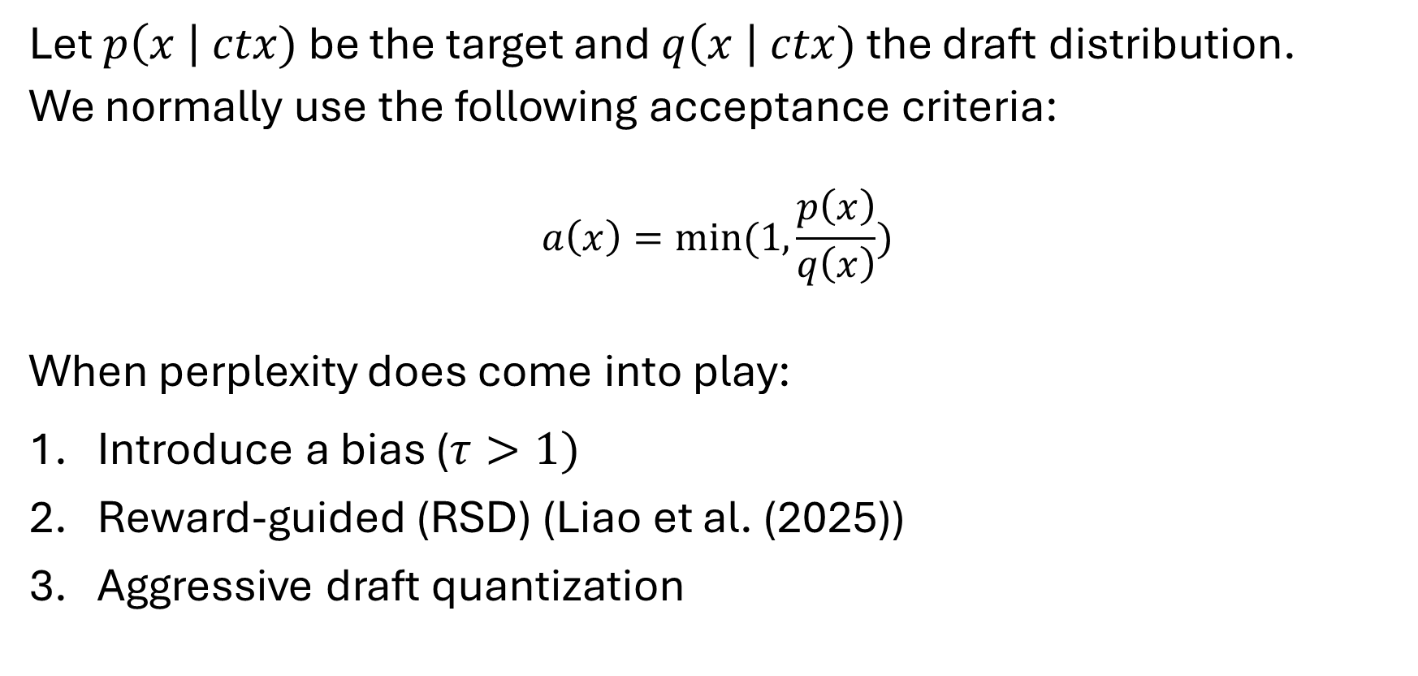
Quality Evaluation
Let $p\left(x \right| ctx)$ be the target and $q\left(x \right| ctx)$ the draft distribution.
We normally use the following acceptance criteria:
$$a\left(x\right)=min⁡(1, \frac{p\left(x\right)}{q\left(x\right)})$$
When perplexity does come into play:
Introduce a bias ($τ>1)$
Reward-guided (RSD) (Liao et al. (2025))
Aggressive draft quantization
Notes:
never sample a token more often than the target distribution allows.

Slide 9
Quality Evaluation
Metrics we actually report include:
Decode throughput (tokens/s)
Latency per token (ms/token)
Acceptance rate (accepted draft tokens / generated draft tokens)
Mean accepted tokens per speculative round
Per-token distribution (aka p_target)

Slide 10
The N-gram Language Model
Instead of computing the probability of a word given its entire history, we can guess the history by just the last few words.
n-gram is a probabilistic model that can estimate the probability of a word given the n-1 previous words
The assumption that the probability of a word depends only on the previous word is called a Markov assumption.

Slide 11
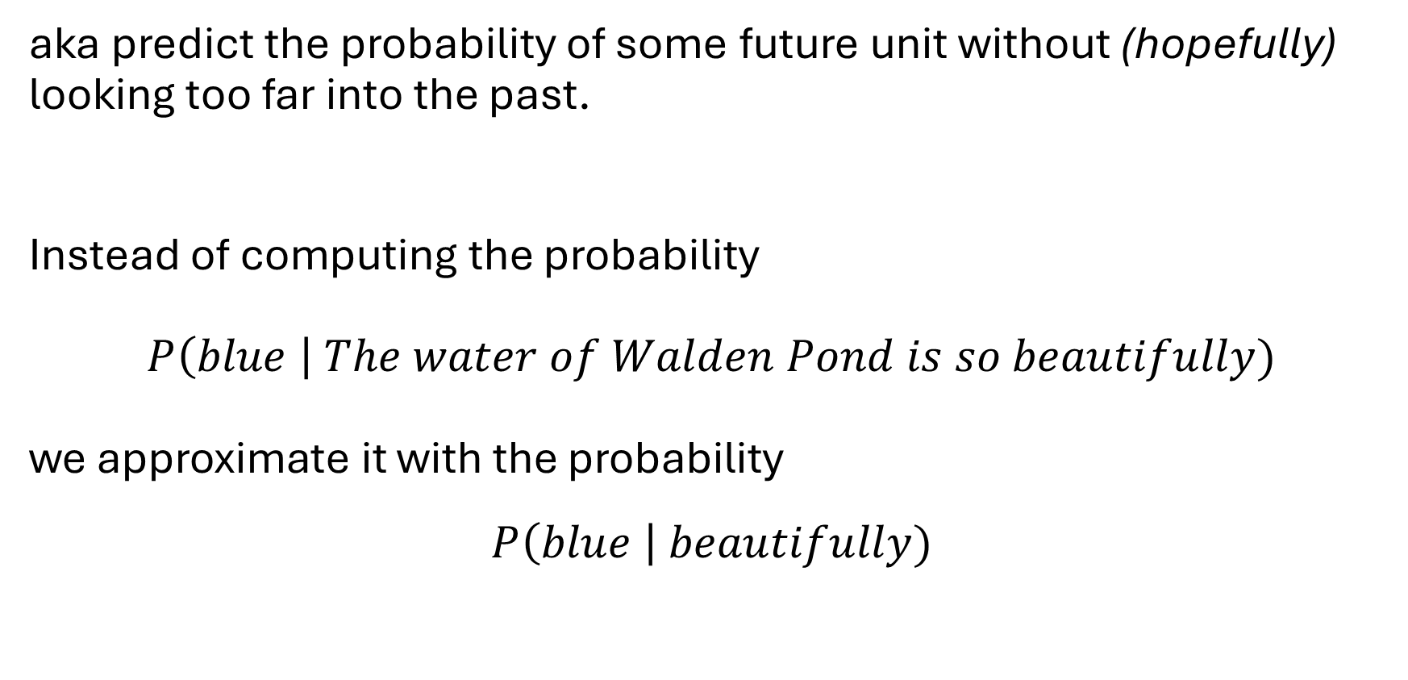
The N-gram Language Model
aka predict the probability of some future unit without (hopefully) looking too far into the past.
Instead of computing the probability
$P\left(blue \right| The water of Walden Pond is so beautifully)$
we approximate it with the probability
$$P\left(blue \right| beautifully)$$

Slide 12
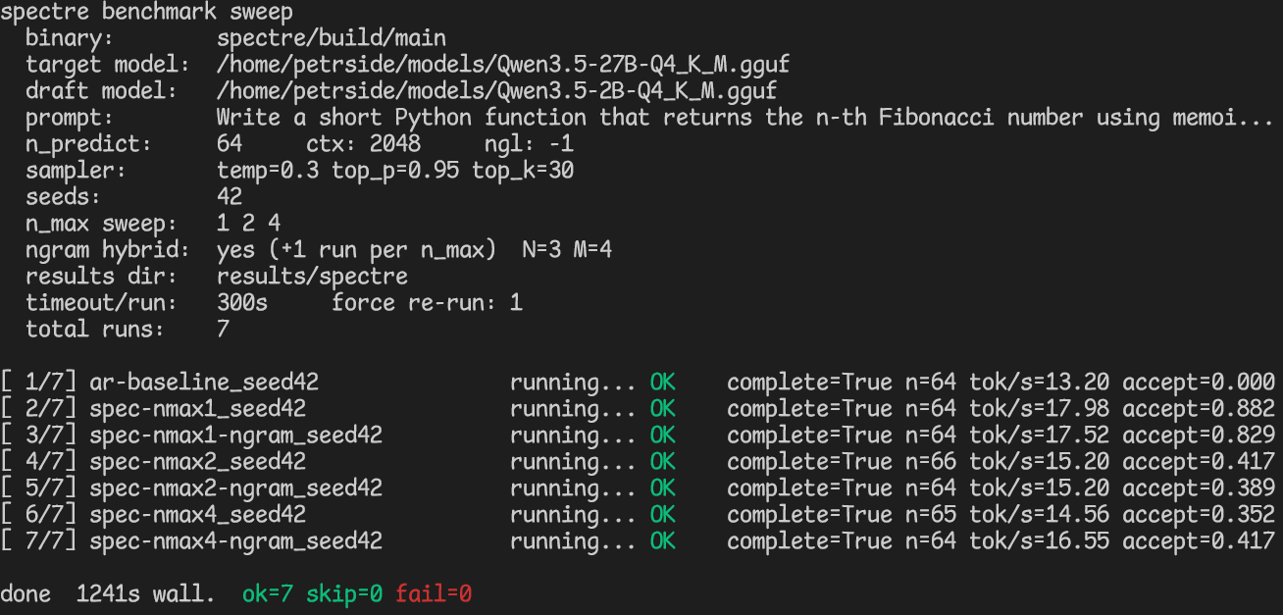

Slide 13
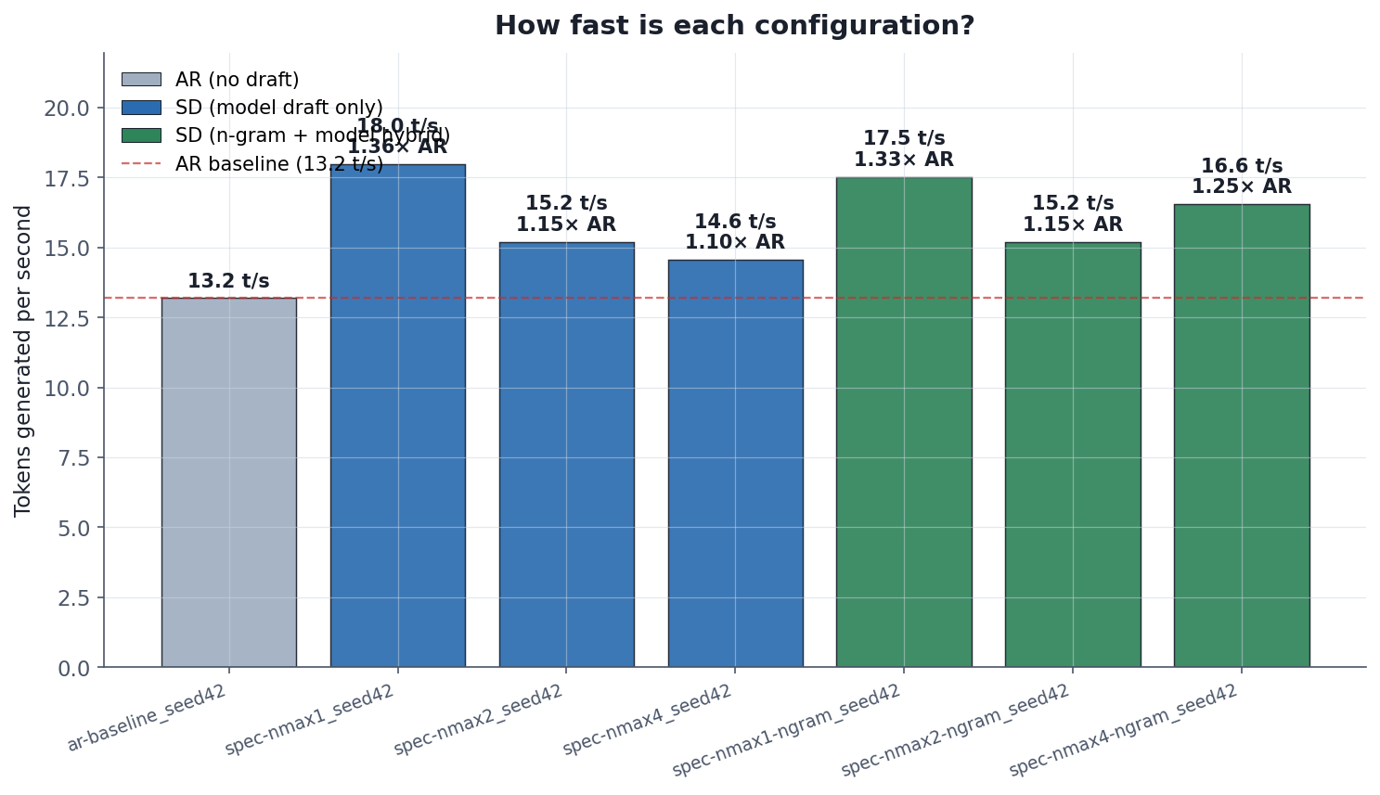

Slide 14
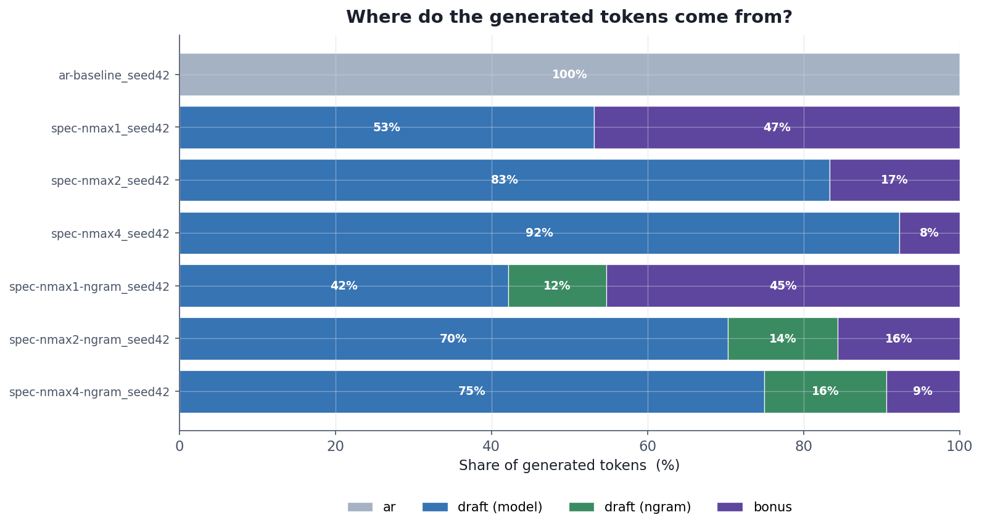

Slide 15
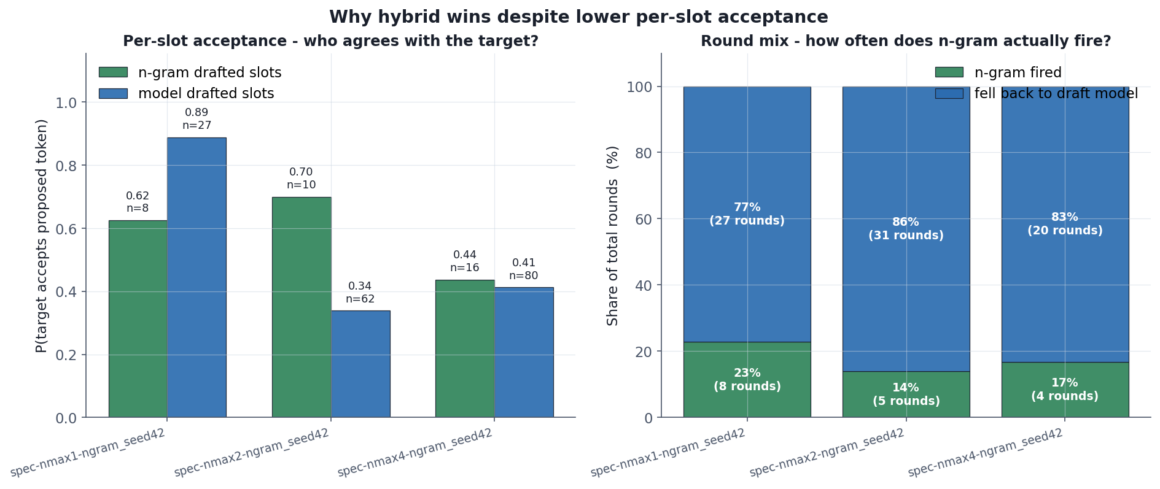

Slide 16
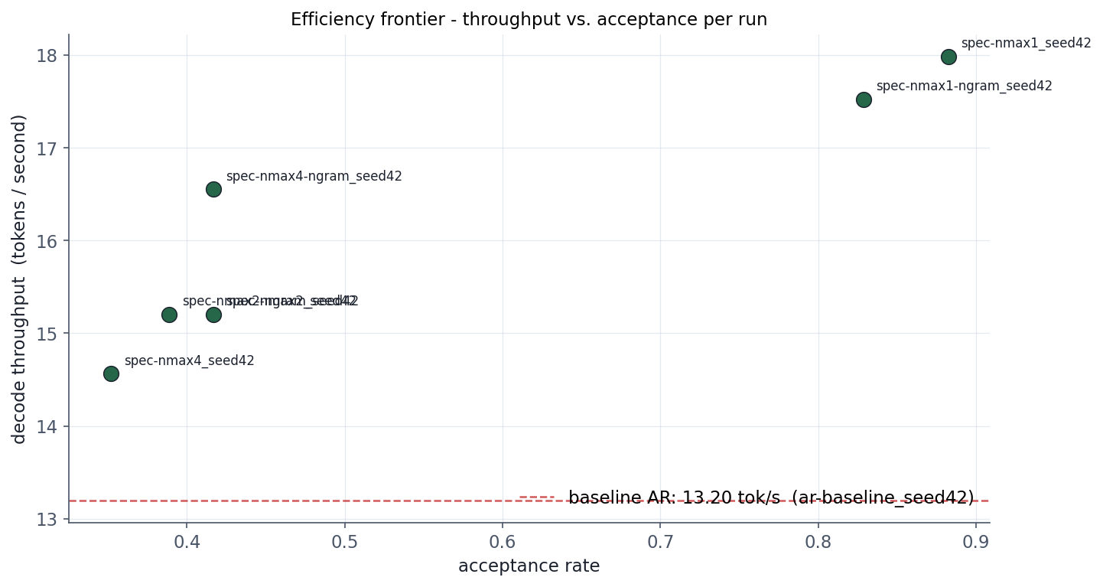

Slide 17
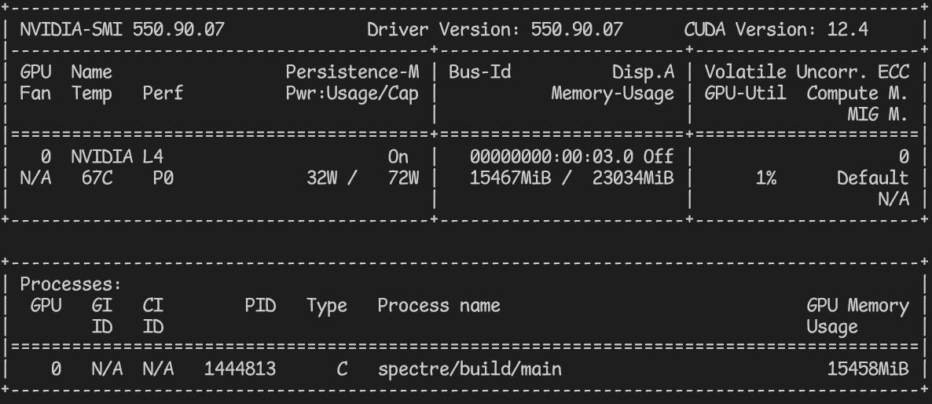

Slide 18
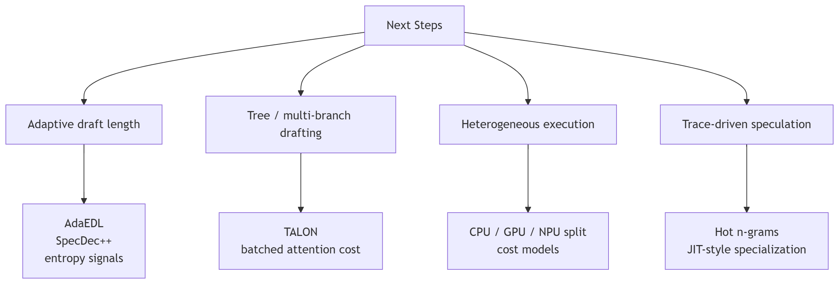
Next Steps

